Slide 1

PaleoPredictive Modelling: Leveraging Machine Learning for Fossil Species Classification

Slide 2

Palaeontology faces significant challenges in extracting detailed information from incomplete fossil remains. The integration of machine learning presents a transformative opportunity to revolutionise the field by uncovering patterns and relationships within fossil data that might be overlooked using traditional methods. This project, aims to evaluate the application of machine learning in paleontological research, developing predictive models to enhance understanding of fossils and offer new insights into the ancient past.
Notes:
Fossilisation is a rare occurrence, with only a fraction of organisms becoming preserved and even fewer being discovered. Environmental factors, biological processes, and geological activities contribute to the uneven distribution and preservation of fossils (Smith, 2003; Peters & Foote, 2001). As a result, the available data often represents only a partial view of the ancient biosphere, with significant gaps in information about the behaviour, physiology, and interactions of extinct species (Gould, 1989).
In light of these challenges, the integration of machine learning into palaeontology presents a transformative opportunity. Machine learning techniques have the potential to revolutionise the field by uncovering patterns and relationships within fossil data that might be overlooked using traditional methods

Slide 3

Defining the Research Question
1
Subject Matter
2
Dataset Features
3
Primary Research Question
Leveraging machine learning techniques to predict dinosaur species from fossil data
Fossil measurements, taxonomic classifications, and geographical information
How can machine learning models be optimised to accurately predict dinosaur species based on fossil attributes, and what role do various features play in enhancing classification accuracy?

Slide 4





Data Source: Paleobiology Database
Comprehensive Repository
Extensive records of global fossil occurrences and associated metadata
Specimens
Detailed records of individual fossil specimens, including identifiers and classifications
Occurrences
Documentation of fossil discoveries at specific geographic locations and stratigraphic intervals
Measurements
Quantitative data related to each specimen, including size and morphological characteristics

Slide 5

Data Collection and Integration
1
Data Sourcing
Collected data from Measurement, Specimen, and Occurrence categories in the Paleobiology Database
2
Integration
Merged datasets using common identifiers like 'occurrence_no' and 'specimen_no'
3
Data Filtering
Excluded occurrences lacking associated measurements to focus on specimens with measurable fossil data

Slide 6
Data Wrangling and Cleaning
Null Processing
Error Corrections
Outlier Management
Imputed nulls in taxonomical levels using literature searches and domain knowledge. Geographical context nulls filled through reverse geocoding using Nominatim geolocator.
Addressed spelling mistakes and mis-recorded measurements using various techniques. Created reference dictionary to replace placeholders with accurate taxonomic information.
Systematically evaluated outliers by reviewing original studies and assessing measurement plausibility. Cross-referenced with existing records and scientific literature.

Slide 7

Exploratory Data Analysis Findings
Dataset Composition
Distribution Characteristics
2,747 measurements from 420 species across 5 categories: length, width, circumference, diameter, and height. Length most frequent (2,055 records), height least common (5 records).
Non-normal distribution confirmed by Shapiro-Wilk test. Positive skewness (1.77) and heavy tails (kurtosis = 4.05) observed. Extreme non-normality in individual measurement types.
Heavily Imbalanced
Taxonomic and Geographic Coverage
Substantial class imbalance in the dataset, with many species having very few samples, which is a common issue in palaeontologic due to uneven fossil discoveries and preservation biases.
8 orders, 118 families, 380 genera, and 386 species. Spans 37 countries, 101 states, and 215 counties. Geological data from 177 formations and 8 lithologies.
Notes:
15 features, 1 target – Geographic location, preservation quality and type, measurements, rock type
2741 Observations
2 Clades, 8 Orders, 118 Families, 380 Genra, 386 species (Unique)
37 Countries
22 Specimen Parts

Slide 8




EDA Insights Continued
Data Distribution
Significant skewness observed, with certain categories dominating the dataset. Characteristic of palaeontological data due to sparse fossil records and uneven discovery distribution.
Multivariate Analysis
Geographic plotting, histograms, box plots, and tree maps elucidate dataset characteristics. Showcases specimen spread across time periods and geological contexts.
Foundation for Analysis
Thorough understanding ensures subsequent stages of analysis are based on a well-represented and accurately interpreted dataset, facilitating informed conclusions in palaeontological study.

Slide 9
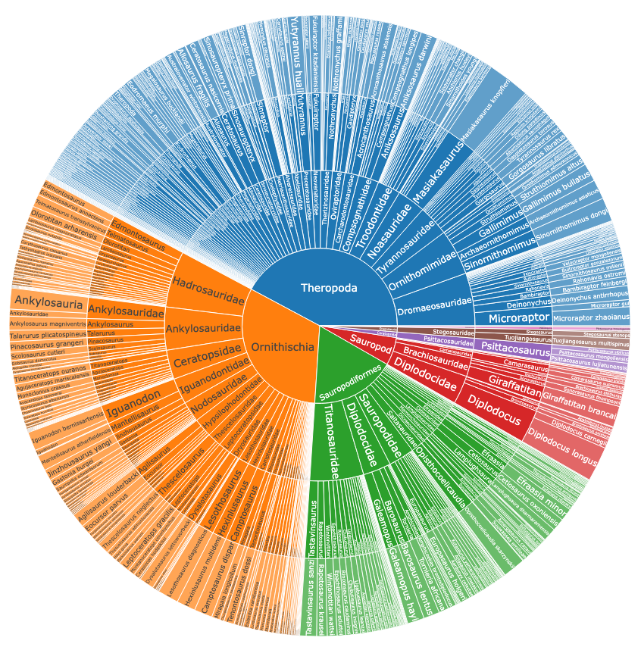

Slide 10
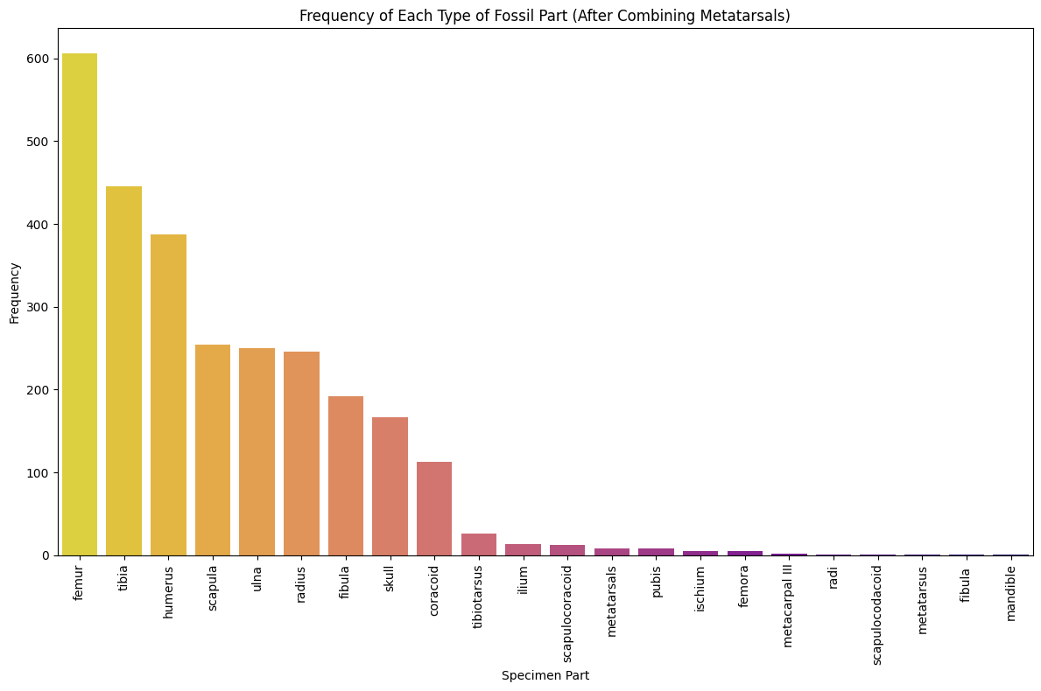
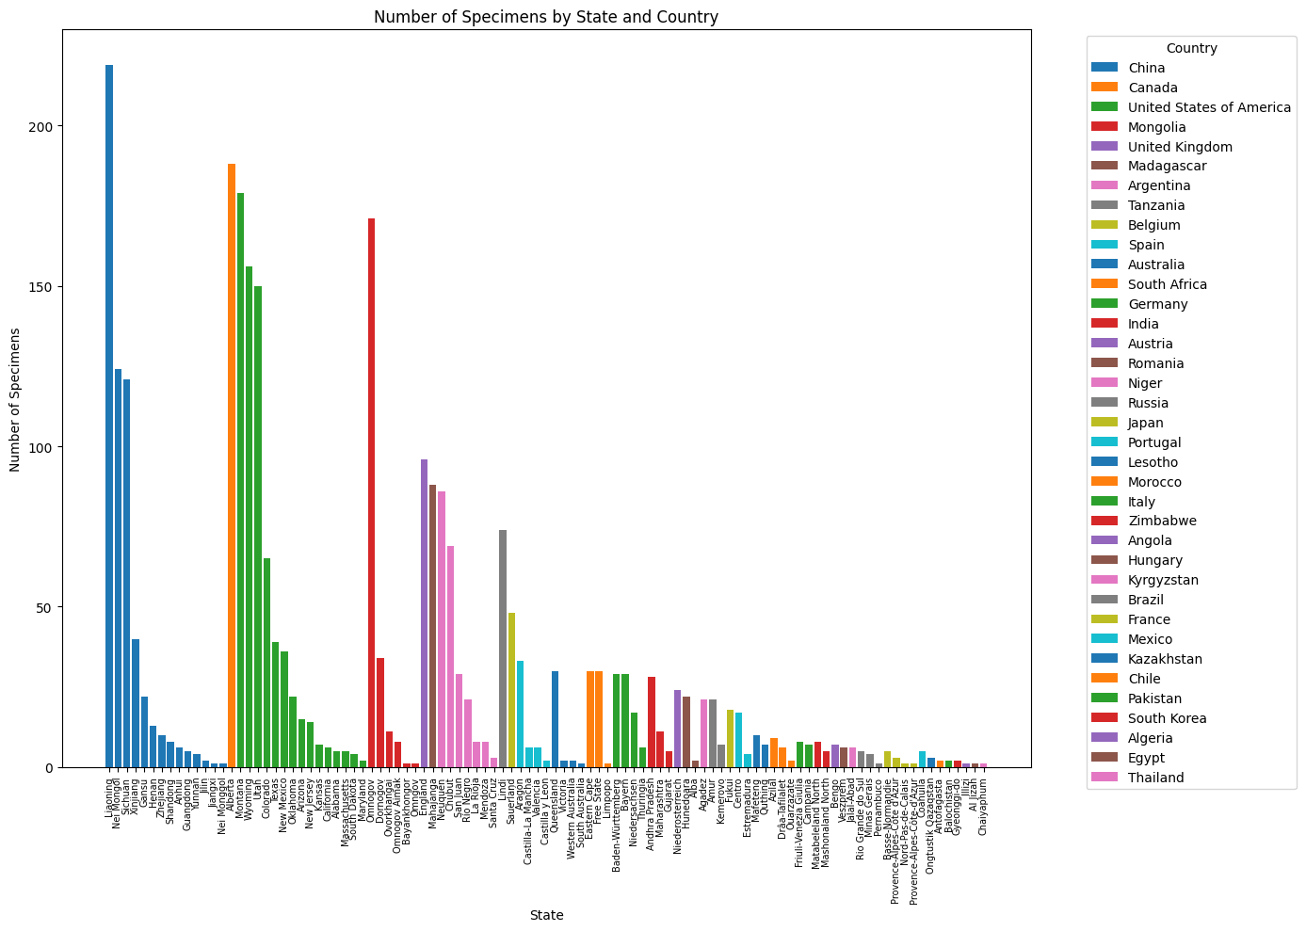
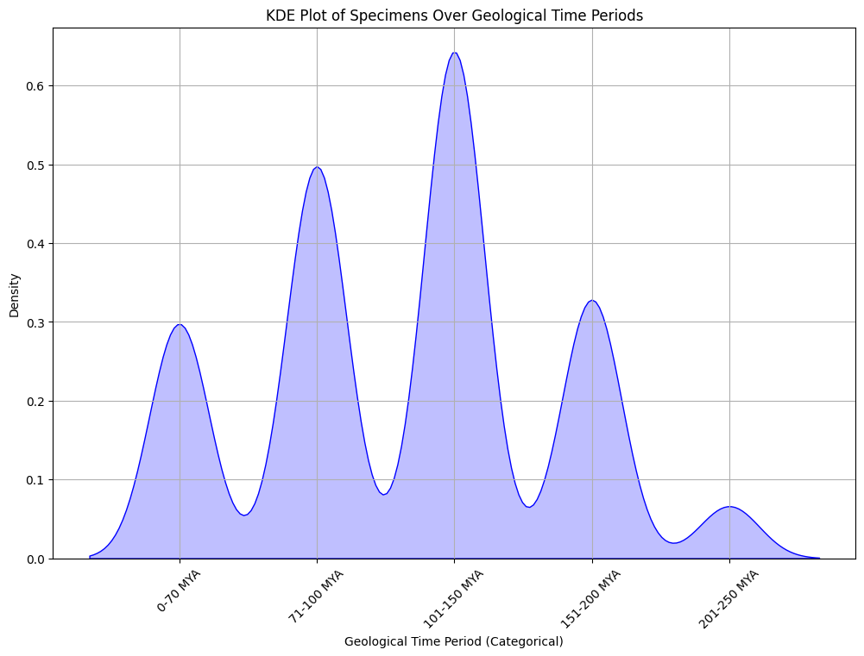
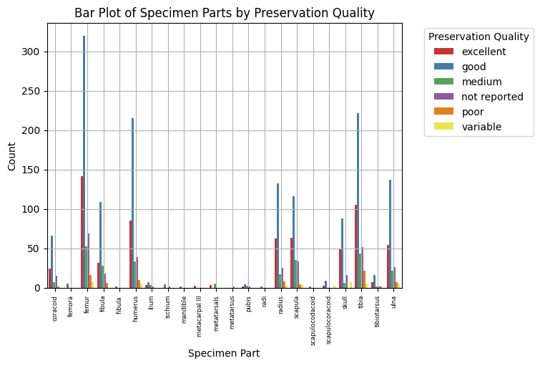
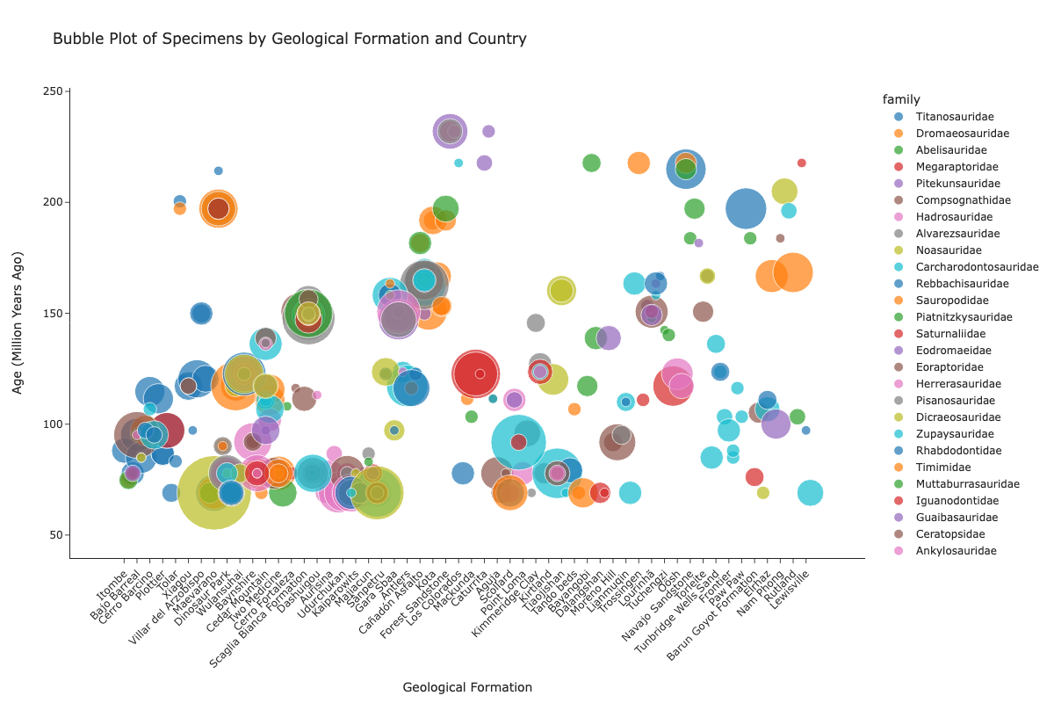
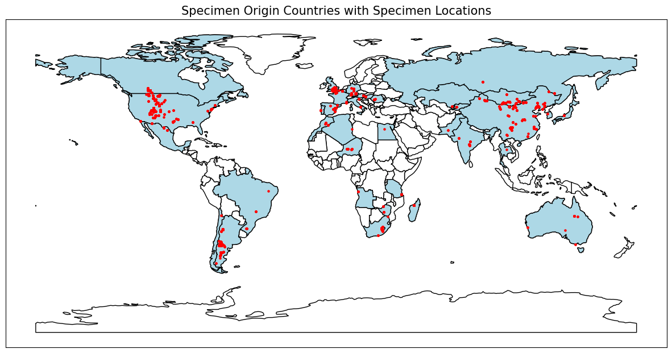

Slide 11
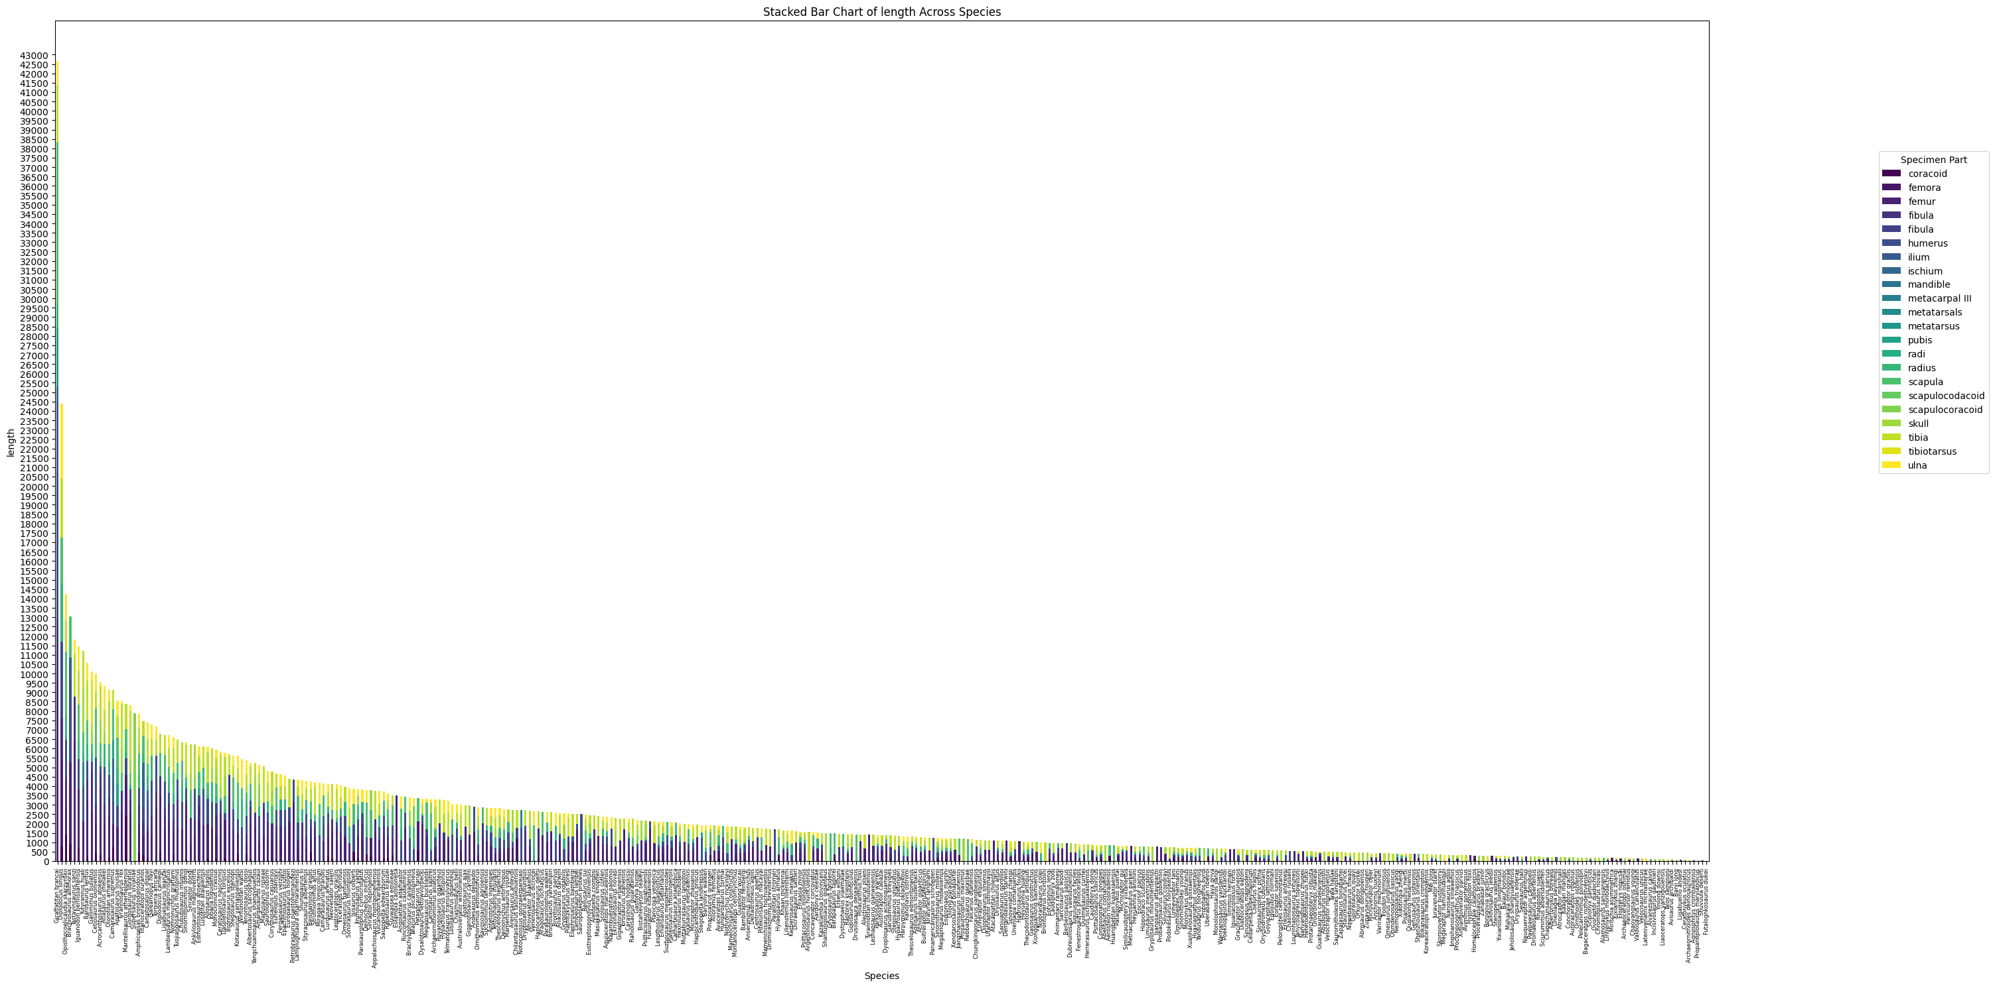

Slide 12

Hypothesis Formation
H₁ (Alternative Hypothesis)
Machine learning models can accurately determine fossil identifications based on attributes such as geographical location, physical measurements, geological age, and lithological context.
H₀ (Null Hypothesis)
Machine learning models cannot accurately determine fossil identifications based on these attributes. Predictive performance is not significantly better than random chance.

Slide 13

Establishing a Baseline
1
Unique Baseline Feature
Data included 'identified name and rank' (initial identification) and 'accepted name and rank' (final identification after rigorous examination)
2
Baseline Accuracy
77.21% accuracy for species identification, with 2,121 correct matches out of 2,747 total records
3
Improvement Potential
While accuracy is reasonable, approximately 22.79% of records did not match the identified species, indicating room for improvement

Slide 14

Model Development for Dinosaur Classification

Slide 15
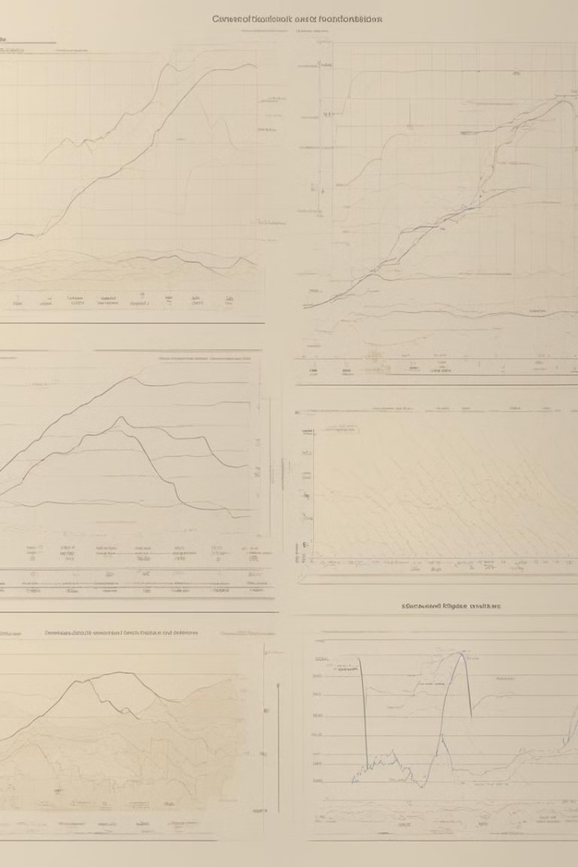
Naïve Bayes Model Evaluation
1
Feature Independence Assumption Violated
Chi-Square tests revealed significant associations among categorical variables, indicating strong interdependencies.
2
Non-Normal Distribution
Shapiro-Wilk test confirmed non-normality for variables like average and overall_ma, even after transformations.
3
Model Unsuitability
Given the violations of Naive Bayes assumptions, the model was deemed unsuitable for the dataset.

Slide 16

Cross Validation with LOOCV
Leave-One-Out Cross-Validation (LOOCV) is a powerful cross-validation technique suited for datasets with limited sample sizes. It thoroughly assesses model performance by iteratively training on all but one data point and testing on the excluded sample, ensuring each instance is used for testing exactly once.
LOOCV maximizes data utilization, especially beneficial for imbalanced datasets where certain species have few instances. It mitigates the variability issues of traditional cross-validation, providing more reliable performance estimates and insights into model generalization.
By comprehensively including every sample, even the rarest species, LOOCV delivers a robust evaluation that helps detect overfitting and guide model adjustments. This makes it a valuable tool when dealing with small or imbalanced data, ensuring thorough assessment of the model's capabilities.
Notes:
Cross-validation is a statistical method for evaluating a machine learning model’s performance and generalizability. It systematically partitions the dataset into multiple subsets, or “folds,” and alternates between training and testing across these folds. This technique reduces the risk of overfitting and ensures the model’s performance is not overly dependent on a specific subset of data, providing a more reliable assessment of its ability to perform on unseen data.
Because of the skew/ imbalance in this data, LOOCV was utilised
• Definition:
LOOCV is a cross-validation technique used to evaluate models, especially effective in datasets with very small sample sizes.
• Mechanism:
• Each data point serves as a test sample once.
• The model is trained on all other data points.
• This process is repeated for every data point, ensuring all are used for testing.
• Advantages:
• Maximises Data Utilisation: Every data point is tested, making it ideal for small datasets.
• Detailed Performance Evaluation: Assesses the model’s generalization by testing on every individual sample.
• Mitigates Variability: Unlike k-fold cross-validation, LOOCV reduces variability in performance estimates, especially important for imbalanced datasets.
• Specific Use Cases:
• Small Sample Sizes: Ensures comprehensive use of data.
• Imbalanced Classes: Guarantees that less frequent classes (e.g., rare species) are included in the test set.
• Outcomes:
• Reliable Performance Estimates: Provides a consistent evaluation, crucial for limited data.
• Overfitting Detection: Helps in identifying overfitting by evaluating the model on single left-out samples.
• Informed Adjustments: Facilitates better model adjustments based on a thorough understanding of performance.

Slide 17

Decision Tree Model Analysis
Model Configuration
Decision Tree with max_depth=15, using entropy criterion. Features: longitude, latitude, county, and overall_ma.
Performance
Strong metrics: accuracy, precision, recall, and F1 score all at 0.83 for both training and testing.
Limitations
Class imbalance persisted. Overfitting identified through learning curve analysis, with training accuracy exceeding cross-validation accuracy.
Notes:
• Hyperparameter Selection:
A grid search identified the most appropriate hyperparameters for the decision tree:
• Max Depth (15): Limited the tree’s depth to prevent overfitting.
• Min Samples Split (1): Allowed splits even with a single sample, accommodating data imbalance.
• Min Samples Leaf (2): Ensured a minimum of 2 samples per leaf, balancing specificity and generalization.
• Max Features: Controlled the number of features considered at each split, aiding generalization.
• Criterion (Entropy): Prioritised information gain for meaningful splits.
• Feature Selection:
The most appropriate features for this model were:
• Latitude and Longitude: Geographic coordinates.
• County/State: Regional data.
• Overall Mean Age (Estimate): Temporal data.
• Model Performance:
The decision tree displayed strong metrics:
• Accuracy, Precision, Recall, F1 Score: All recorded as 0.83 for both training and testing datasets.
This uniformity suggests that the model is performing reliably, with a balanced ability to correctly predict both positive and negative cases. The equal precision and recall values indicate that the model is effectively minimizing both false positives and false negatives, making it well-suited for the given task.
• Analysis:
• Class Imbalance: The issue of class imbalance persisted despite model adjustments.
• Overfitting: Identified through learning curve analysis, where training accuracy exceeded cross-validation accuracy, indicating the model’s tendency to perform better on the training data compared to unseen data.
Overall, the tree is performing well, demonstrating a strong ability to generalize across the dataset. However, the persistence of class imbalance and indications of overfitting suggest that while the model’s performance is robust, further refinement may be necessary to enhance its generalization to unseen data, especially in scenarios with imbalanced classes.
• Accuracy (0.83): Indicates that 83% of the predictions made by the model were correct. This suggests a reliable level of overall performance, though it should be interpreted alongside other metrics due to potential class imbalance.
• Precision (0.83): Reflects that 83% of the samples predicted as positive were actually positive. This indicates the model’s effectiveness in minimizing false positives.
• Recall (0.83): Demonstrates that 83% of the actual positive cases were correctly identified by the model. This highlights the model’s capability in capturing true positives and is crucial in contexts where missing positive instances is costly.
• F1 Score (0.83): A balanced metric that combines precision and recall, confirming that the model performs consistently well across both dimensions, even when considering the potential trade-off between precision and recall.
Gini Impurity:
• Purpose: Measures how often a randomly chosen element would be incorrectly classified.
Entropy:
• Purpose: Measures the level of uncertainty or disorder in a node.

Slide 18





Pruned Decision Tree (DT2) Evaluation
Model Adjustment
Max depth reduced from 15 to 5 to address overfitting.
Improved Generalization
Learning curve showed narrowed gap between training and cross-validation scores.
Performance Drop
Significant decrease in accuracy, precision, recall, and F1 scores for both training and testing.
Conclusion
Pruning improved generalization but led to underfitting, suggesting need for more sophisticated techniques.
Notes:
For Tree 2, the depth was manually reduced from 15 to 5, resulting in a significant drop in all metrics to approximately 0.16.
Interpretation:
• Reduced Depth (5): Limiting the tree depth constrained its complexity, preventing it from capturing intricate patterns in the data.
• Performance Metrics (~0.16): The drop in accuracy, precision, recall, and F1 score indicates that the model became overly simplistic. This simplification led to poor performance, as the tree could not adequately differentiate between classes or capture relevant patterns.
Summary:
Reducing the tree depth to 5 significantly decreased model performance, suggesting that the initial depth of 15 was more appropriate for capturing the necessary complexity and detail in the data.

Slide 19
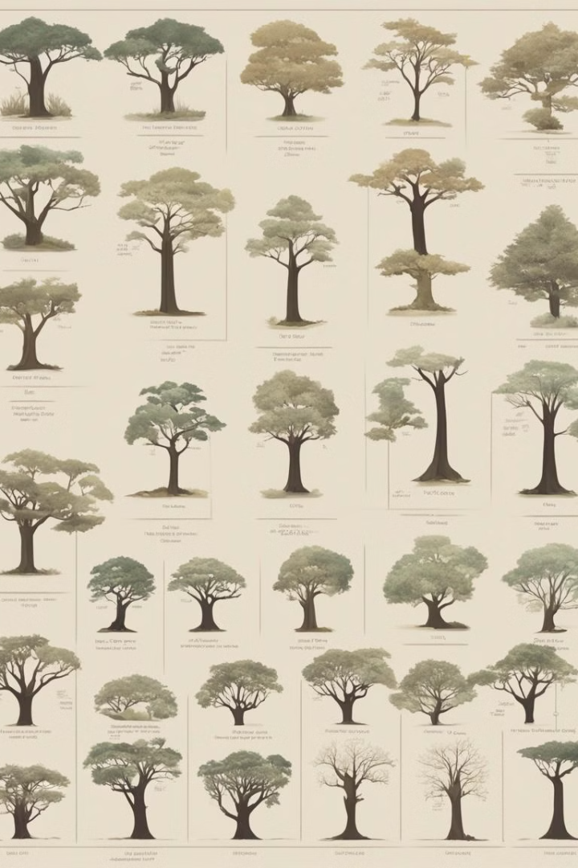
Random Forest Model Implementation
Hyperparameters
n_estimators=100, max_depth=15, criterion='gini'
Features
longitude, latitude, state, county, formation, lithology1, lithology2, average, length, overall_ma
Training Performance
Accuracy, precision, recall, F1 score: 0.97
Testing Performance
Accuracy, precision, recall, F1 score: 0.87
Best CV Score
0.89
Notes:
• Hyperparameters:
• n_estimators (100): Number of trees in the forest.
• Max Depth (15): Maximum depth of each tree.
• Criterion (Gini): Measures the quality of splits based on Gini impurity.
Feature selection determined longitude, latitude, state, county, formation, lithology1, lithology2, average, length, overall_ma
Training scores 0.97, which dropped to 0.87 for testing
Interpretation:
• Training Performance: The model shows very high accuracy, precision, recall, and F1 score of 0.97, indicating it performs exceptionally well on the training data. This suggests that the model has learned the patterns in the training data effectively.
• Testing Performance: The metrics for testing data are lower (0.87), which indicates a drop in performance. This suggests that while the model is well-tuned for the training data, it may not generalise as well to new, unseen data.
Summary:
The Random Forest model performs exceptionally on training data but shows a notable decrease in performance on testing data, indicating potential overfitting. The high performance on the training set suggests that the model is effectively capturing the relationships in the data, but the drop in testing performance highlights the need for further evaluation and possibly adjustments to improve generalisation.

Slide 20
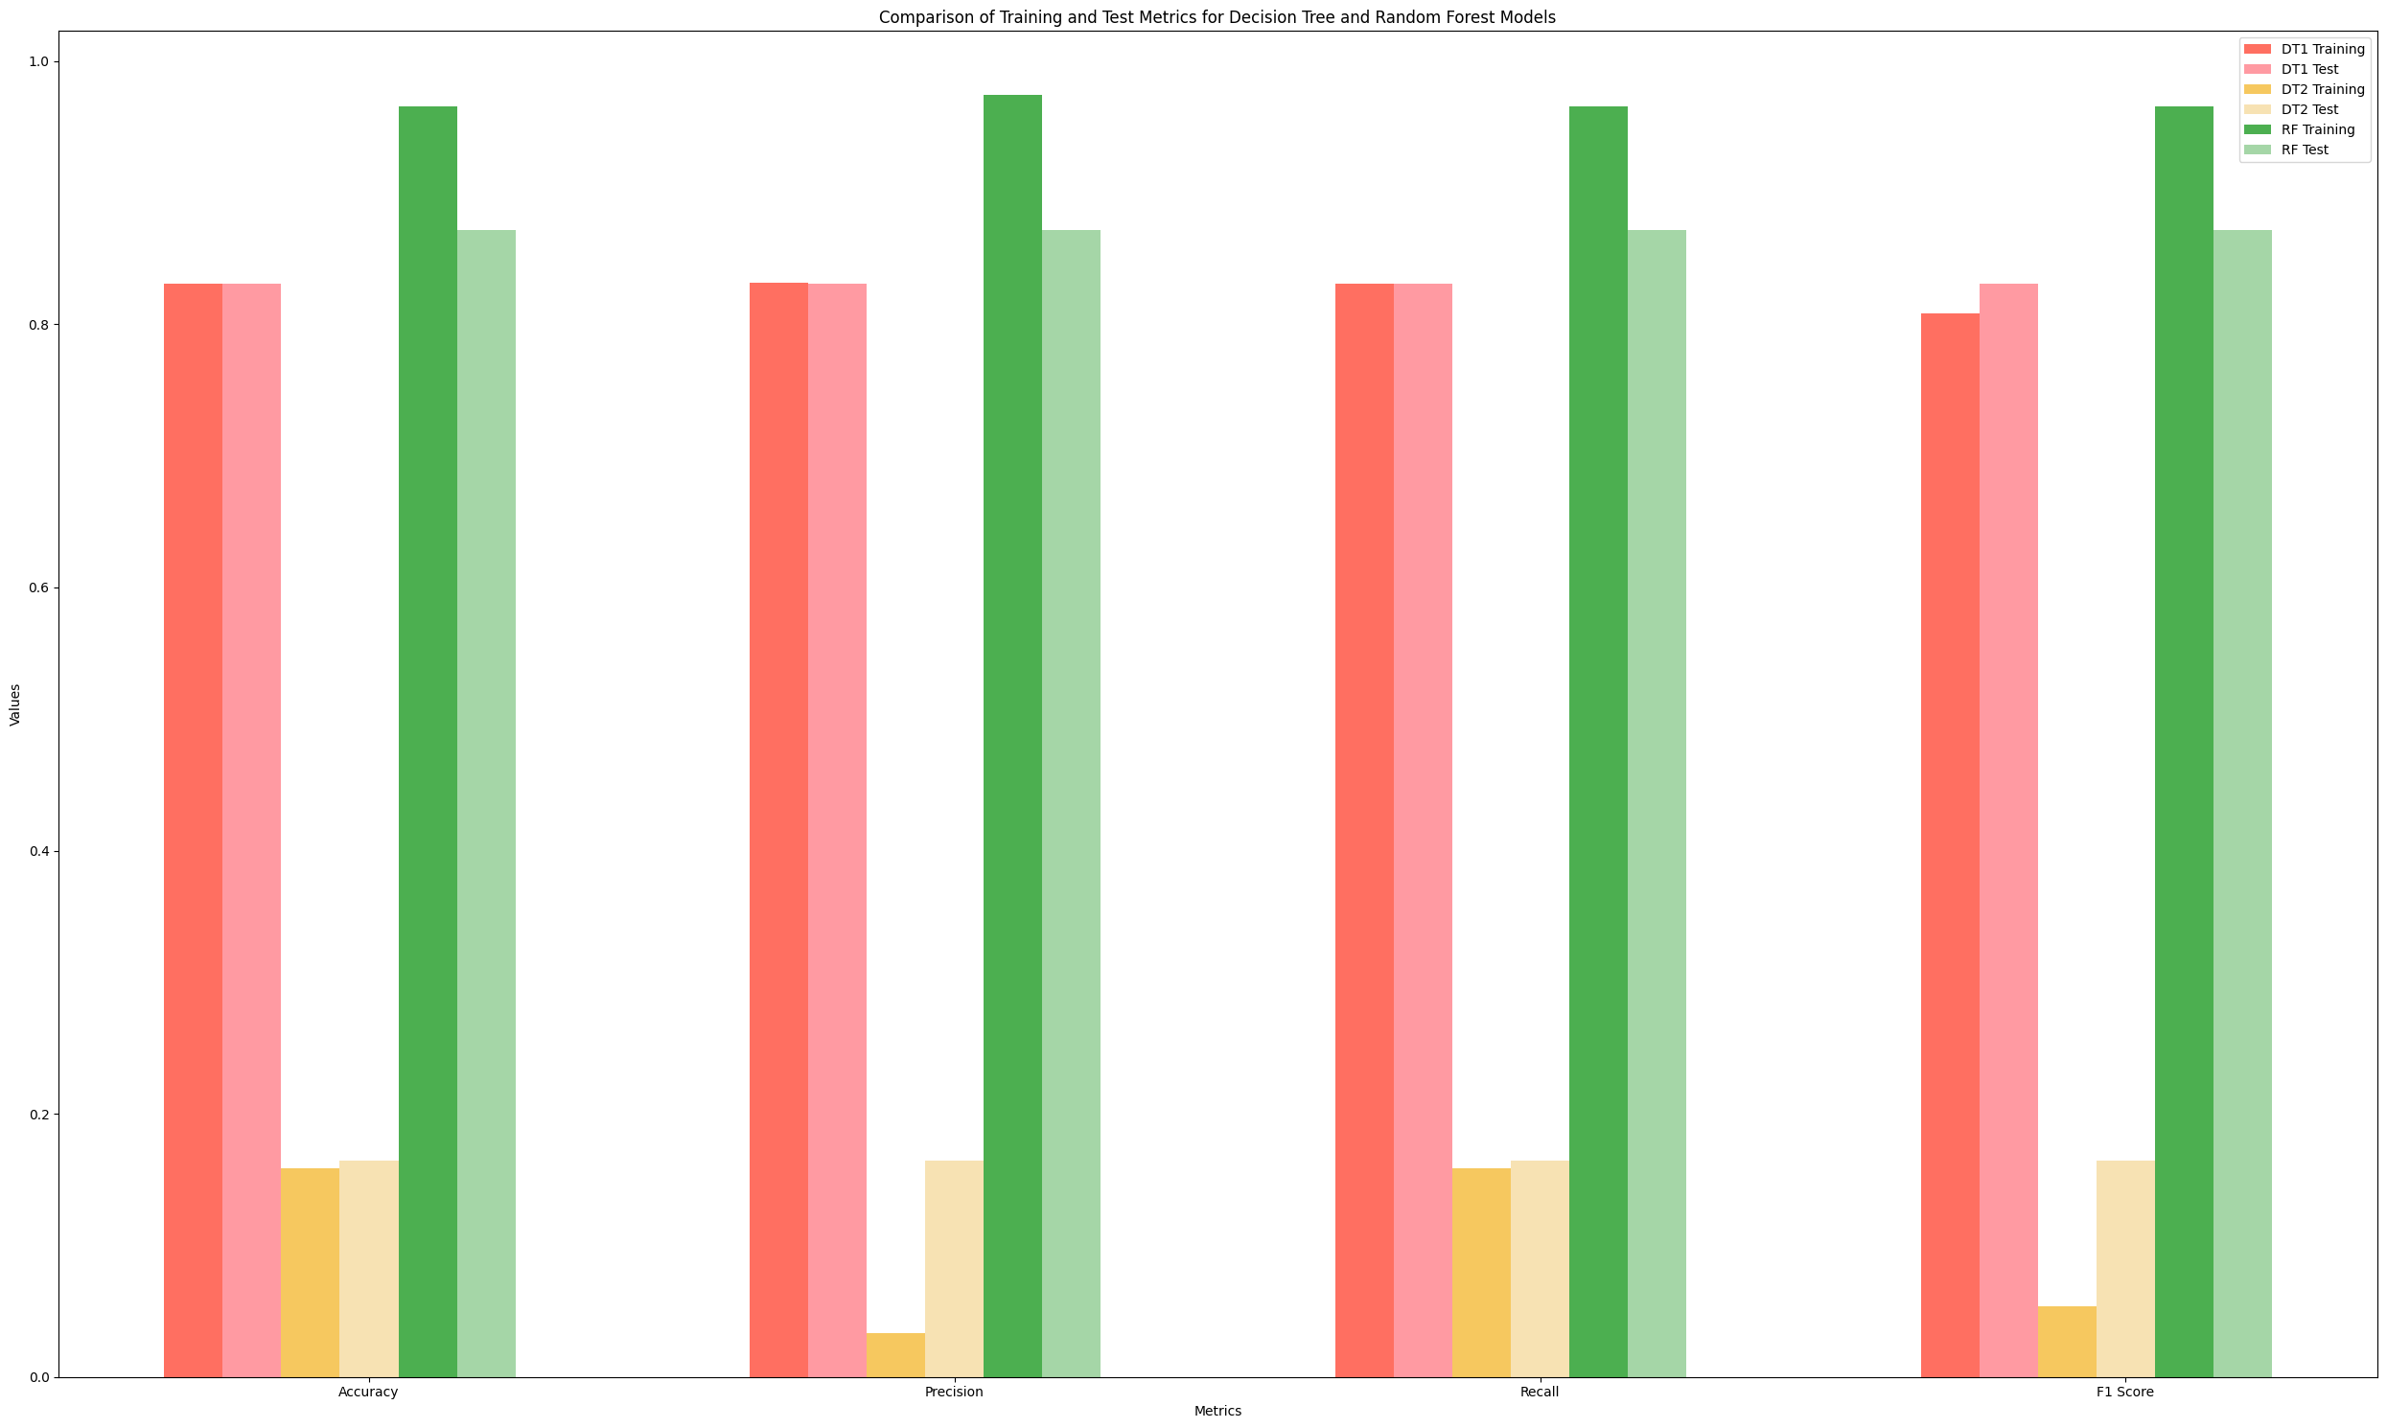
Model Training and Testing Assessment

Slide 21
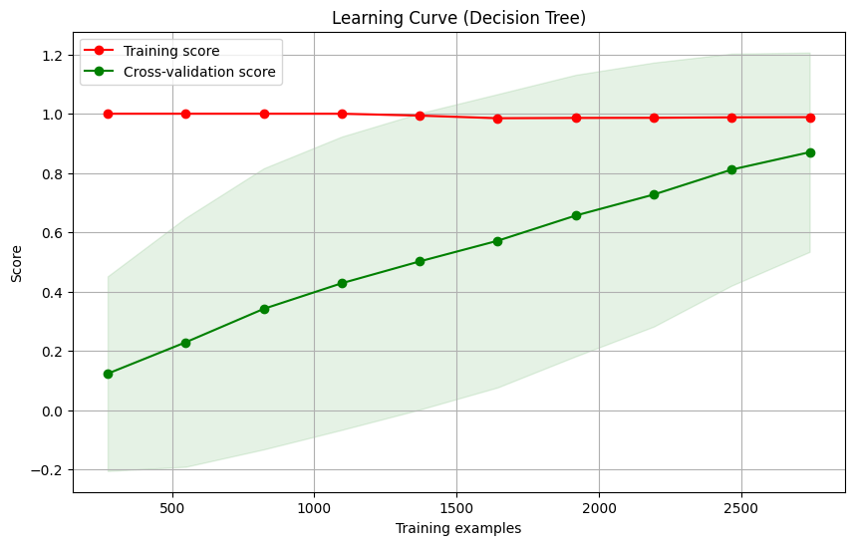
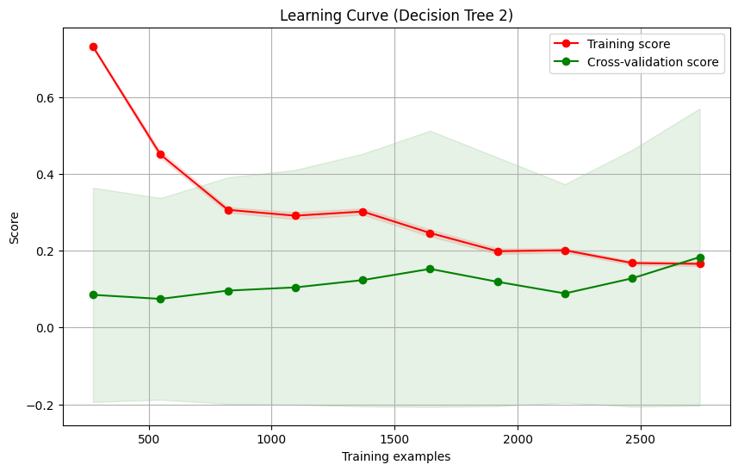
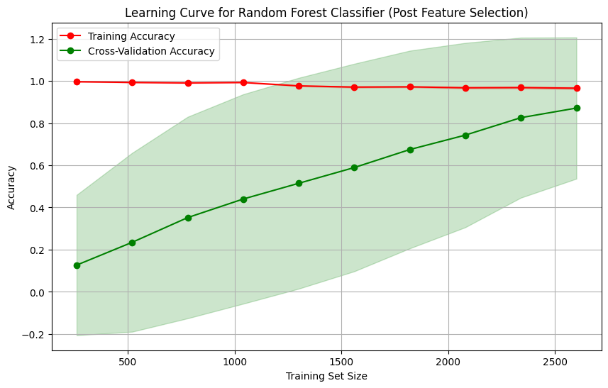
Learning Curves – Decision Tree 1 & 2, and Random Forest
Notes:
Decision tree 1 and random forest
• Overfitting Indicated: Training score quickly approaches near-perfect accuracy, while cross-validation score increases more slowly and remains lower.
• Discrepancy in Scores: The gap between training and cross-validation scores highlights the model’s struggle to generalise to new data, with a tendency to overfit.
• Narrowing Gap with More Data: While the gap slightly decreases with additional data, the model still performs better on training data compared to cross-validation data.
• Recommendations:
• Advanced Feature Selection: Focus on the most relevant features to reduce complexity and potential noise.
• Ensemble Methods: Use techniques like Random Forests or Gradient Boosting to improve robustness and generalisation by combining predictions from multiple models.
• Geographical Features: The model’s heavy reliance on latitude and longitude suggests overfitting to these specific features, indicating the need for a balanced approach to feature selection and model evaluation to avoid undue influence from a few variables.
Decision tree 2
• Reduction in Depth: Simplifying the tree from depth 15 to 5 aimed to reduce overfitting and improve generalisation.
• Improved Generalisation: The new learning curve shows a significant narrowing of the gap between training and cross-validation scores, indicating better generalisation to unseen data.
• Performance Impact: Despite improved generalisation, there was a dramatic drop in accuracy, precision, recall, and F1 score, suggesting the model is now underfitting due to excessive simplification.
• Recommendation: Explore more sophisticated techniques, such as ensemble methods, to balance model complexity and generalisation, addressing the trade-off between overfitting and underfitting.

Slide 22
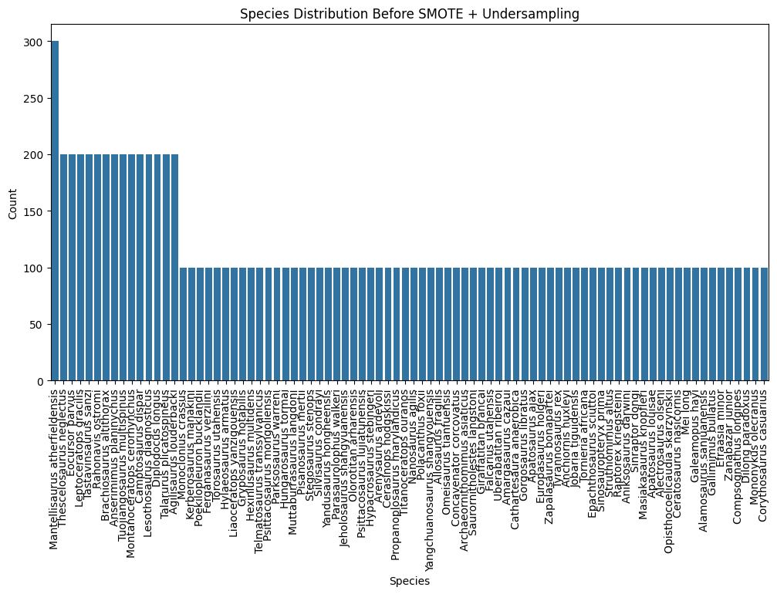
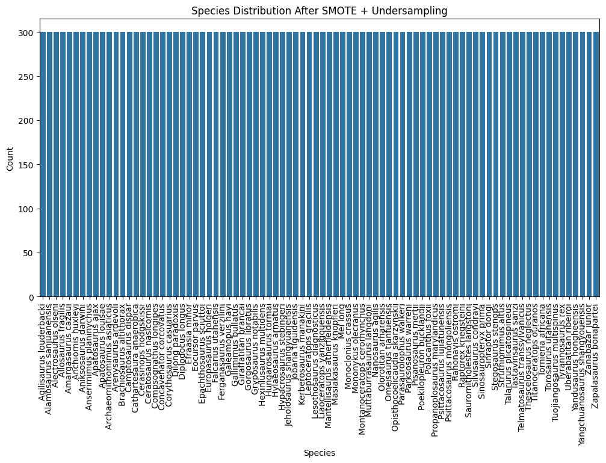
Data Imbalance and Initial Strategies
1
Class Imbalance Identified
Dataset showed significant class imbalance, with some species having numerous samples while others had only one, skewing model predictions.
2
Hybrid Approach Proposed
Initial strategy involved class weights, SMOTE, and random undersampling to address imbalance.
3
Strategy Adjustment
Due to insufficient sample sizes, data were reclassified into broader clades—Saurischia and Ornithischia—for resampling.
4
Final Approach
Decision Trees and Random Forests chosen for their robustness in managing class imbalance through class weights.

Slide 23
Bagging Classifier with K-Nearest Neighbours (KNN) and Random Forest (RF2)
Bagging Classifier with KNN: The KNN model achieved perfect performance metrics, including 1.0 scores for accuracy, precision, recall, F1, ROC AUC, Gini Index, and Purity. However, this indicated severe overfitting, with the training scores significantly exceeding the cross-validation scores, suggesting poor generalization to new data.
Random Forest (RF2): Similarly, the Random Forest model with 200 trees and a maximum depth of 30 also exhibited perfect scores across all metrics on both the training and test datasets. Like the KNN model, the RF2 model demonstrated clear signs of overfitting, with a notable gap between the flawless training performance and the lower cross-validation results.
Limitations: The perfect performance metrics for both models raised concerns about their robustness and real-world applicability. The significant discrepancy between training and cross-validation scores indicated that the models had memorized the training data rather than learning to generalize effectively. This overfitting issue was likely caused by model complexity and potential redundancy in feature selection, leading to excessive sensitivity to the training data.

Slide 24
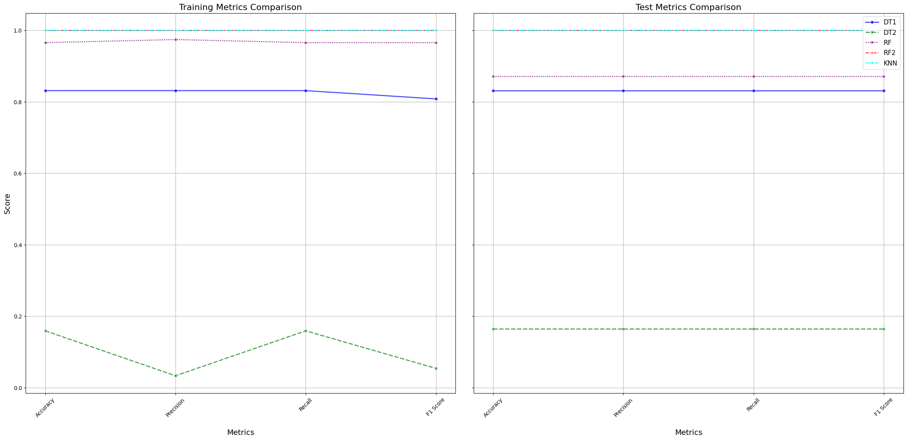
Model Training and Testing Assessment

Slide 25
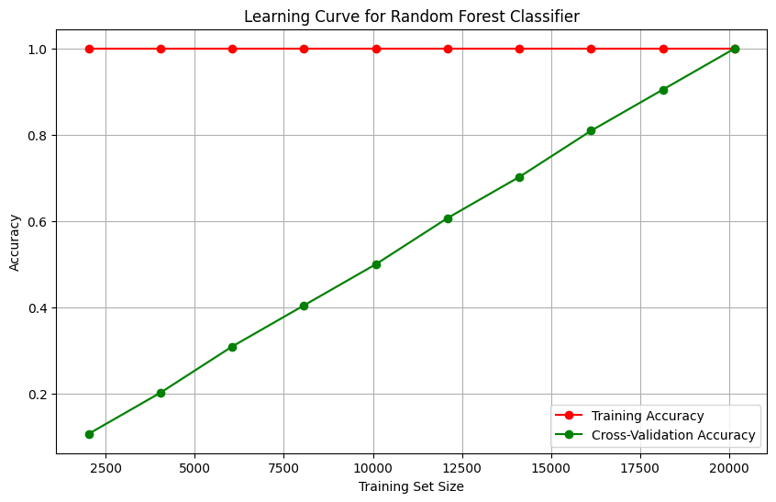
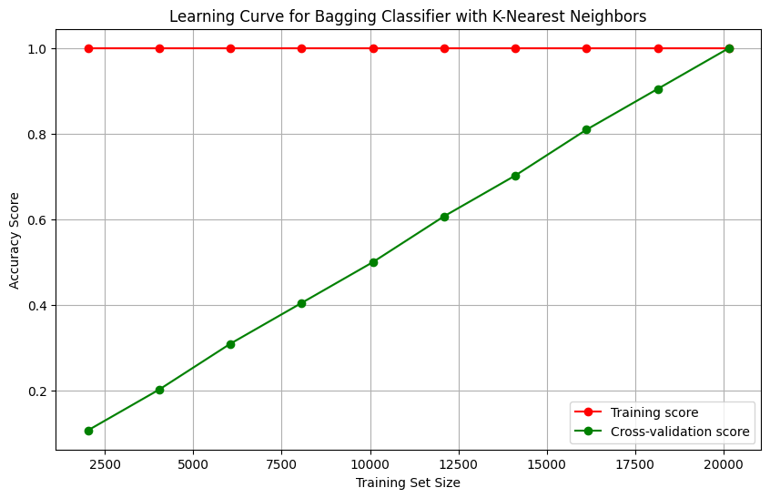
Learning Curves – Bagging Classifier with K-Nearest Neighbours (KNN) & Enhanced Random Forest
Notes:
Learning Curve Analysis for Random Forest and K-Nearest Neighbours (KNN)
• Overfitting Indicated: Both the Random Forest and KNN models exhibit severe overfitting.
• Training Score: Remains consistently high (1.0) across various training set sizes, indicating perfect memorisation of the training data.
• Cross-Validation Score: Starts low and increases gradually with larger training sets but remains significantly lower than the training score, showing poor generalisation.
• Performance Gap: The large gap between training and cross-validation scores highlights that the models are too complex, fitting the training data perfectly but failing to generalise to new, unseen data.

Slide 26
External Model Validation and Generalisation Assessment
The final stage of the analysis involved the critical evaluation of machine learning models through external validation, designed to assess their generalization capabilities on data not previously encountered during training. The validation data underwent the same preprocessing as the training dataset, and the trained models were applied to this unseen data to evaluate key performance metrics.
Decision Tree model (DT1) achieving limited generalisation effectiveness at 33.33% accuracy.
The Random Forest model (RF1) demonstrated better but still subpar results at 66.67% accuracy
while the extended Random Forest (RF2) and K-Nearest Neighbours (KNN) models showed severe overfitting with accuracies of 16.67% and 0.00%, respectively.
Compared to the baseline accuracy of 77.21% achieved through traditional palaeontological methods, the machine learning models fell short, underscoring the challenges in achieving performance on par with conventional species identification. These findings point to the need for further model refinement, exploring alternative algorithms, and employing advanced techniques to address class imbalance and enhance predictive accuracy in paleontological research.

Slide 27
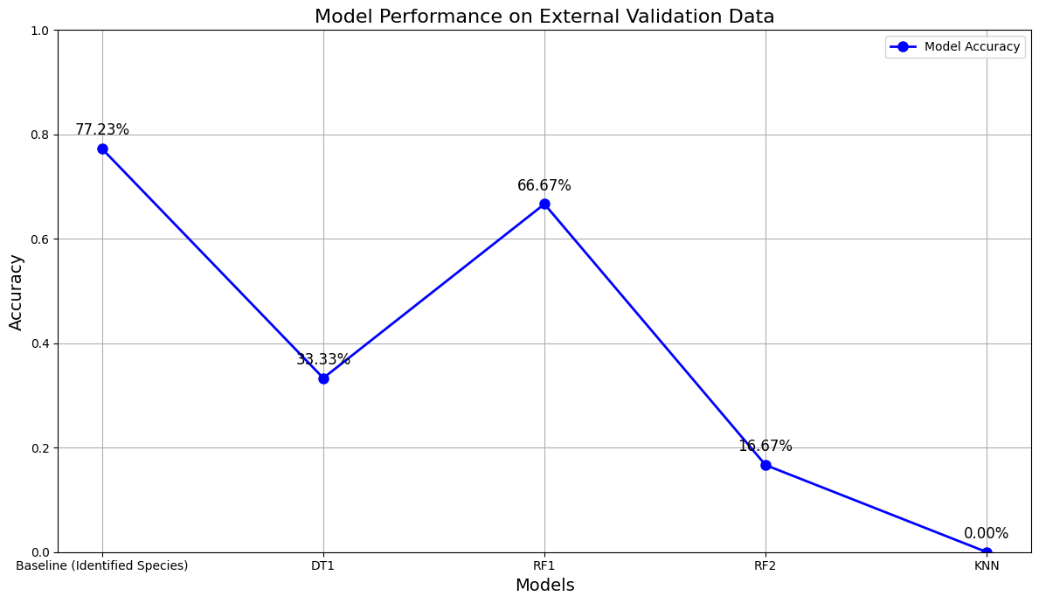
External Model Validation and Generalisation Assessment

